Slide 1
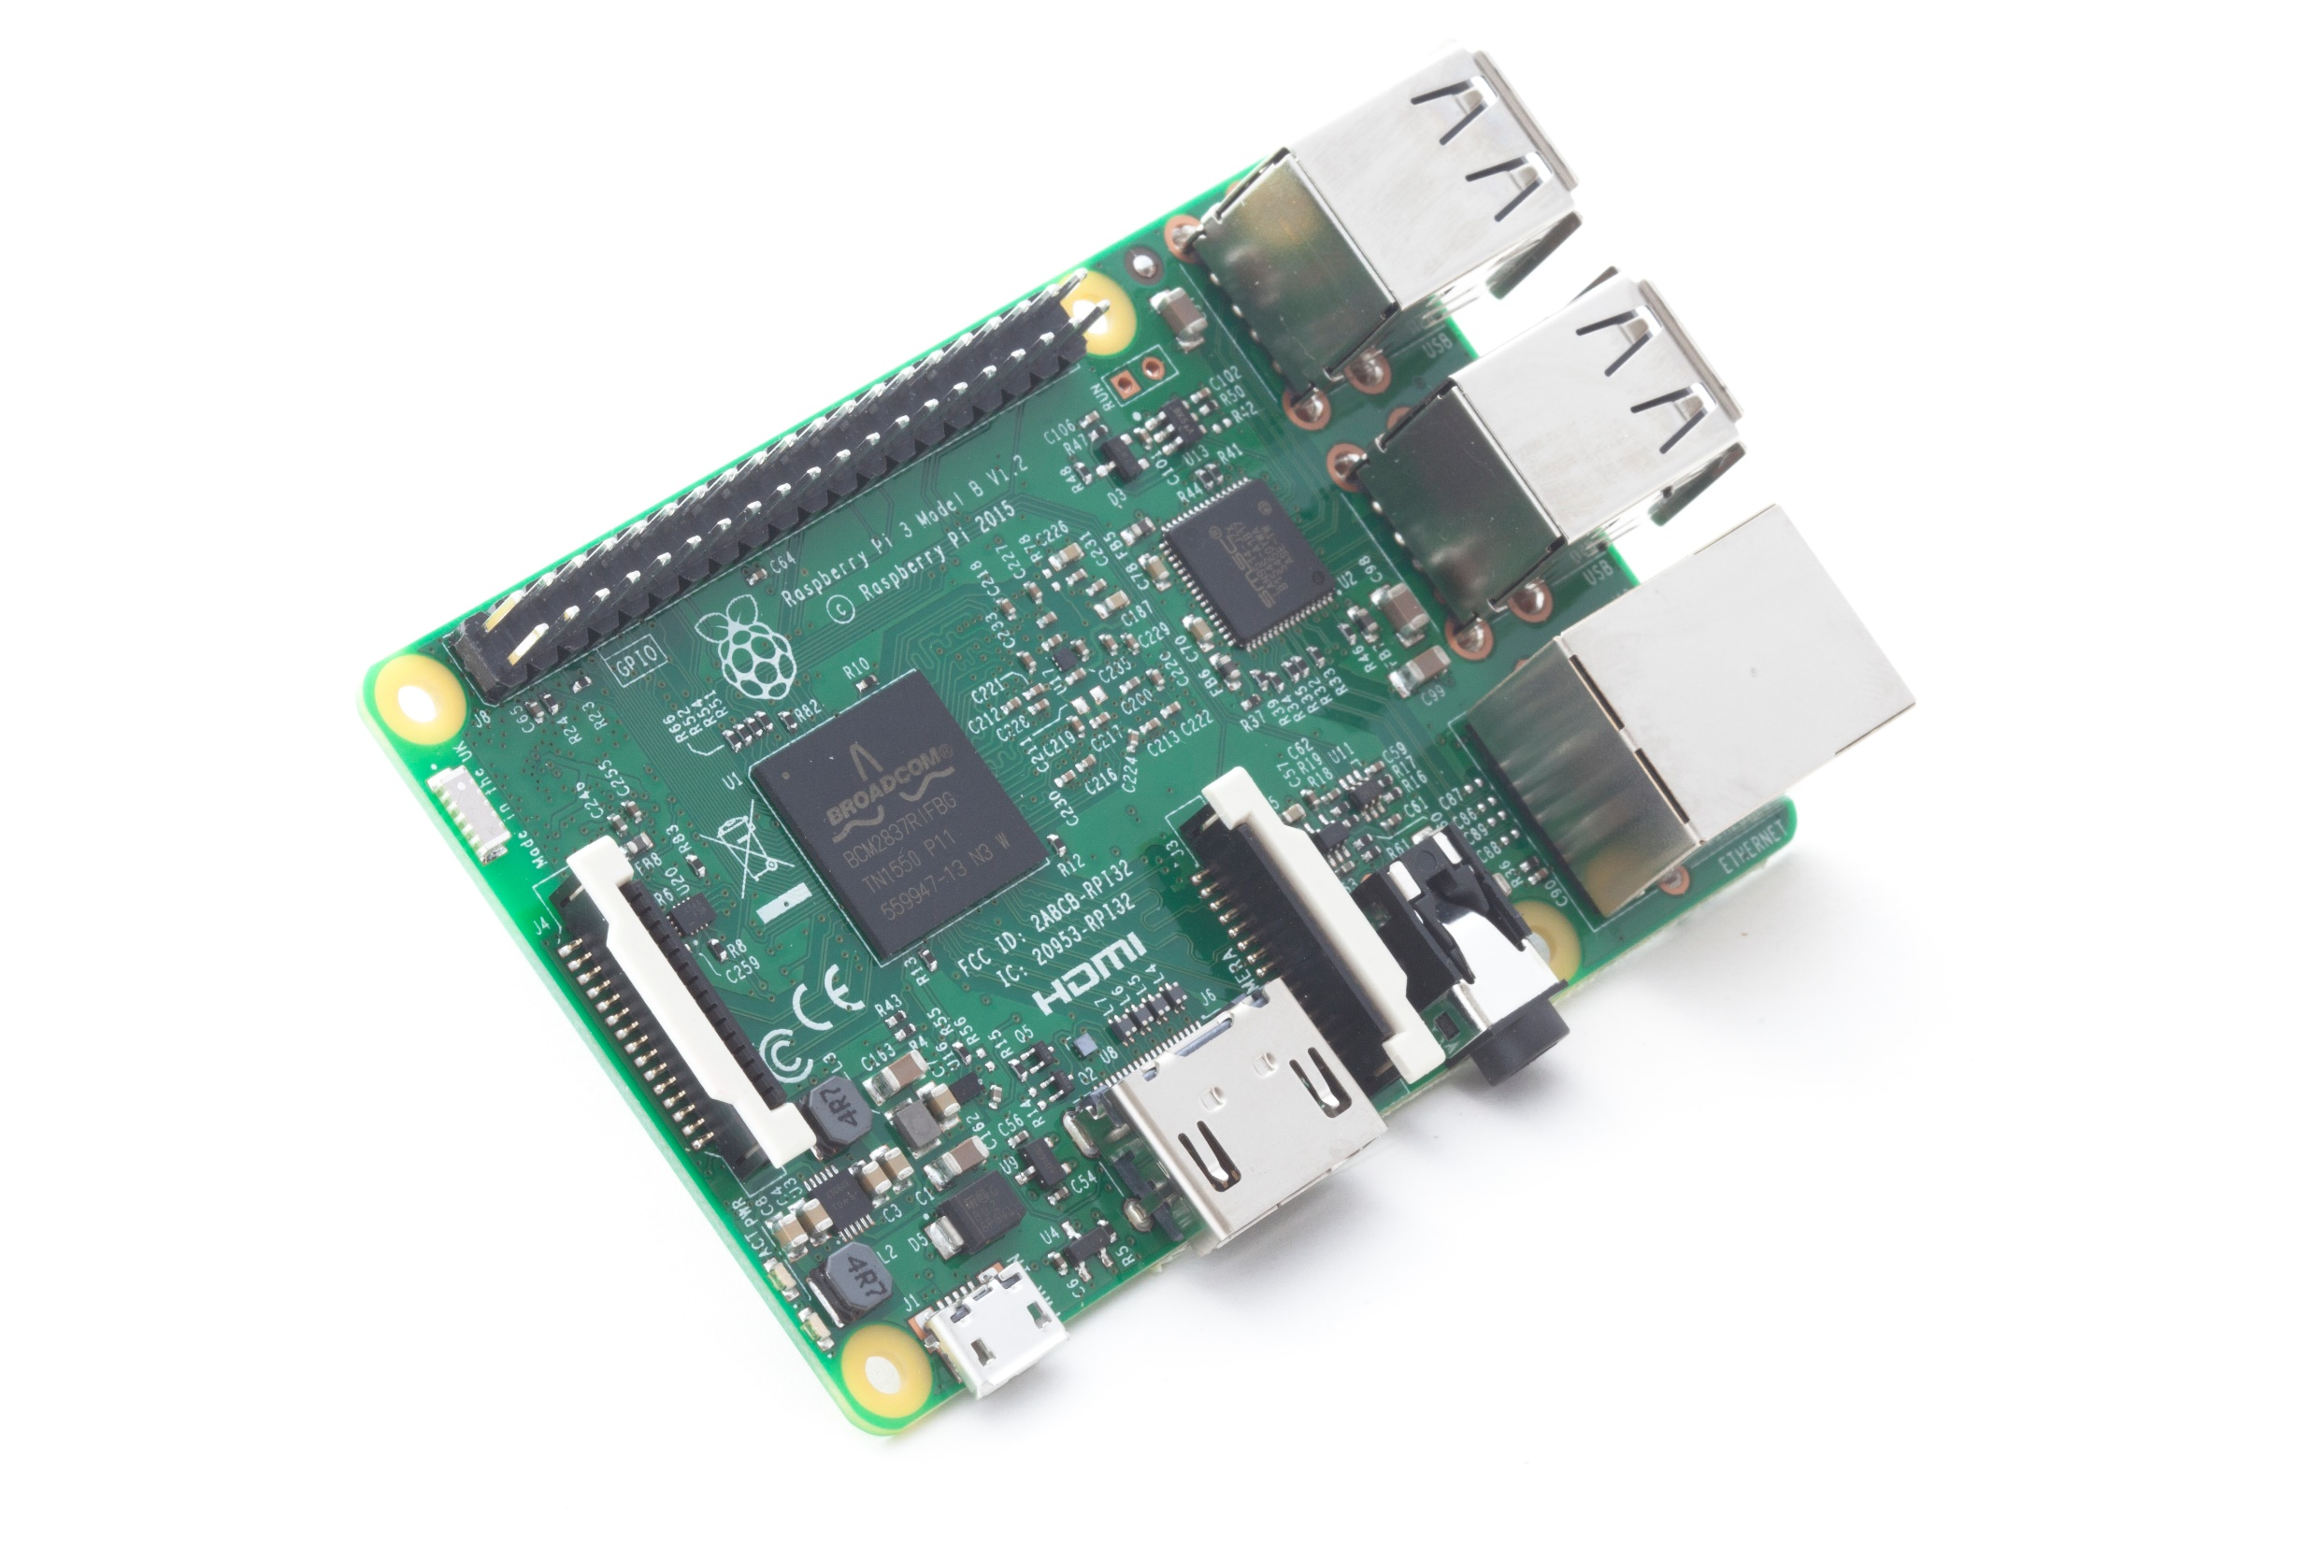
Raspberry Pi 3 - Giveaway
Enter To Win!

